Slide 1
Consistency in Development Essential psychology for assessors

Slide 2

Learning Outcomes
By the end of this session you will be able to…
critically evaluate your own feedback to referees and recognise the issues that influence quality and consistency of feedback
Notes:
In this short session, I really want you to evaluate your own performances as an AFC Assessor from last year, what did you do well and what do you need to improve in your performance. Consistency in development is critical no matter which country from AFC you are from. We are all AFC Assessors we need to assess the referees on their performance and not because who they are.

Slide 3


Their future in
your hands
Notes:
Every time you attend a match as an assessor, you have a great opportunity to add value to the future performances of the referees. I would ask you just one moment of pause, ask yourself this question: Have I completed the assessment accurately and offered quality feedback? Before you click the mouse button to confirm your assessor's report

Slide 4

Referee
Assessor
…being more of a coach who helps the referee perform better in the future…
Notes:
One of the most difficult responsibilities assessors find is how to give advice that will help the referees to improve their future performances. Too often we fall into the trap of telling the referees what we would do in the same situation rather coaching the referee to come up with their own solution. Sometimes the feedback can be trivial and demotivate the referees

Slide 5

Notes:
One of the most difficult responsibilities assessors find is how to give advice that will help the referees to improve their future performances. Too often we fall into the trap of telling the referees what we would do in the same situation rather coaching the referee to come up with their own solution. Sometimes the feedback can be trivial and demotivate the referees

Slide 6
Role of the Assessor
It is easy to find faults, but not so easy to give advice as to how to improve performance
…don’t be fault finders - be performance influencers!
Notes:
One of the most difficult responsibilities assessors find is how to give advice that will help the referees to improve their future performances. Too often we fall into the trap of telling the referees what we would do in the same situation rather coaching the referee to come up with their own solution. Sometimes the feedback can be trivial and demotivate the referees

Slide 7


Role of the Assessor
Notes:
When we want to develop our top referees, we need to consider the root causes to their performance improvement both positive and development areas and not just focus on the mistakes. Wind the performance back, what happened and was this the cause?

Slide 8

Role of the Assessor
Notes:
This is a very interesting slide and one which I want you to take with you every time you assess the performances of all the referees. Having strong roots gives us great stability and with greater stability, much improved and consistent future performances. Make our referees strong with quality advice, using your experience to guide and support.
Picture Courtesy of Alistair Smith Learning

Slide 9

AFC Assessment Scheme
ADDS VALUE from the assessor
GAINS VALUE for the referees
ENHANCES VALUE for AFC
Notes:
Every assessment scheme, it doesn’t matter which country should always add value from the assessor, gains value for the referees and more importantly, gives value to AFC for ensuring the right people are promoted, have the right people refereeing the top matches and for our top referees to be recognised on the international stage.

Slide 10
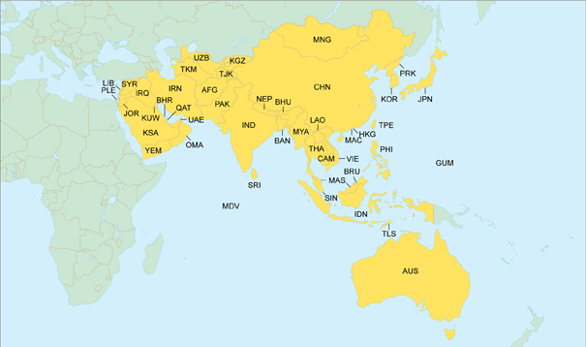
How can we be consistent in development?
Notes:
We all follow the same Laws of the Game yet there is different interpretations on the application of the Laws. This is why these seminars are so important to calibrate our understanding, close the gap and agree decisions collectively.

Slide 11


Slide 12
Group Exercise
How do we prioritise feedback?
In your tables, please discuss the factors you take into consideration when prioritising your development feedback to the referees?

Slide 13

How do we prioritise feedback?
Referees
Control of the game
Match Management
Fitness & Positioning
Team Work
Notes:
Use the assessment form to help guide you in your feedback. But ensure the advice has some meaning and relevance to the referees

Slide 14
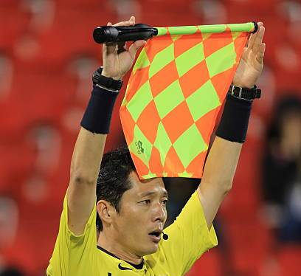
How do we prioritise feedback?
Assistant Referees
Accuracy of decisions & signals: offside situations, fouls, throw ins, goal kicks etc.
Flag Technique, position and movement
Notes:
Use the assessment form to help guide you in your feedback. But ensure the advice has some meaning and relevance to the referees

Slide 15
Prioritising your feedback
Important
Urgent and Important
Needs to be improved
Important but not urgent
Needs to improve over time
Urgent
Not Urgent
Urgent but not important
Helpful and not critical
Not urgent and not important
Avoid or Ignore
Not Important
Notes:
As with every match, it is important that we sort the important from the unimportant and the urgent (need to do immediately) to the non urgent, minor faults that does not need to be discussed.

Slide 16





Common mistakes in the report

Slide 17
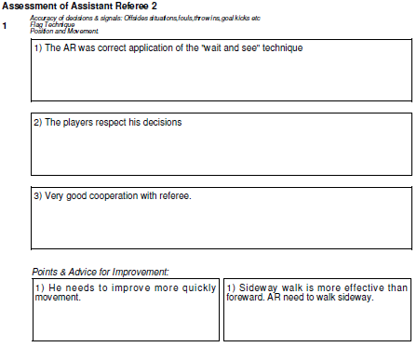
Sample Reports
Very Good Performance
Medium Difficulty
Assistant Referee
Mark
8.7

Slide 18
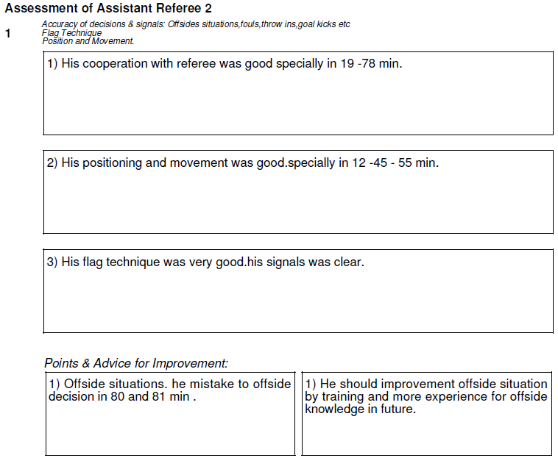
Good Performance
Medium Difficulty
Assistant Referee
Mark
8.4

Slide 19
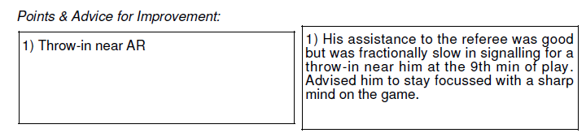
Major or Minor Advice or Don’t mention?

Slide 20
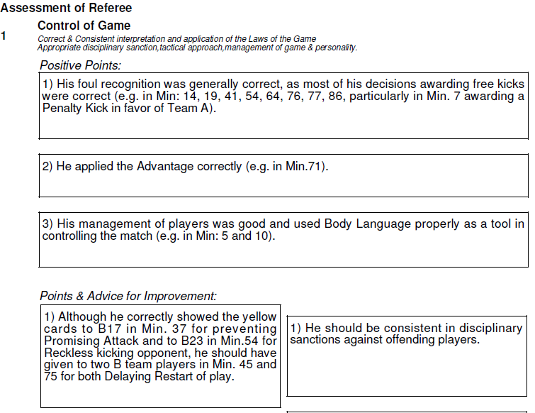
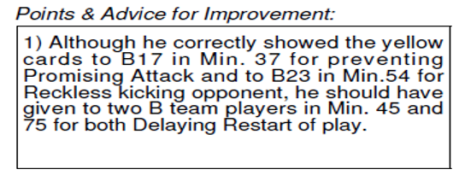
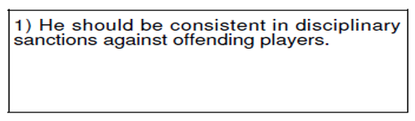
Good Performance
Medium Difficulty
Referee Mark
8.4

Slide 21
Assessment Guidelines – Advice
Assessment Report
Positive Points
Use timed reference points from decisions (but not every decision)!
Describe what you saw – evidence (brief)
The positive points must justify the mark you are awarding

Slide 22
Assessment Guidelines – Advice
Assessment Report
Points and Advice for Improvement
Use timed reference points which clearly have an impact on performance
Use your experience to offer advice on how to improve performance
The negative points may have an affect on the mark you are awarding

Slide 23
Any Questions?

Slide 24
Summary
Prioritise the strengths and development areas
Constructive comments
Advice and support
Ability to motivate

Slide 26
Thank you

